Slide 1


Bachao Every life is important for us
Final Defense
Bangladesh University of Business and Technology (BUBT)
Development of Web Based Application of Online Assistance for Emergency Situation

Slide 2
Supervised by
Developer’s Info
Final Defense
Developed by
Mohammad Nayem
14153103103
Ashraf Chowdhury
14153103128
Shumsuzzoha Sunam 14153103094
Md. Shadizzaman Assistant Professor,
Department of Computer Science and Engineering
Bangladesh University of Business and Technology (BUBT)

Slide 3
Final Defense
Overview
Introduction
Motivation of Project
Objectives
Methodology
Use Case Diagram
Database
Project Screenshots
Functional Requirements
Features
Development Procedure
Entity Relationship Diagram
Expected Outcomes
Technology Used
Future Plans
Conclusion
References

Slide 4
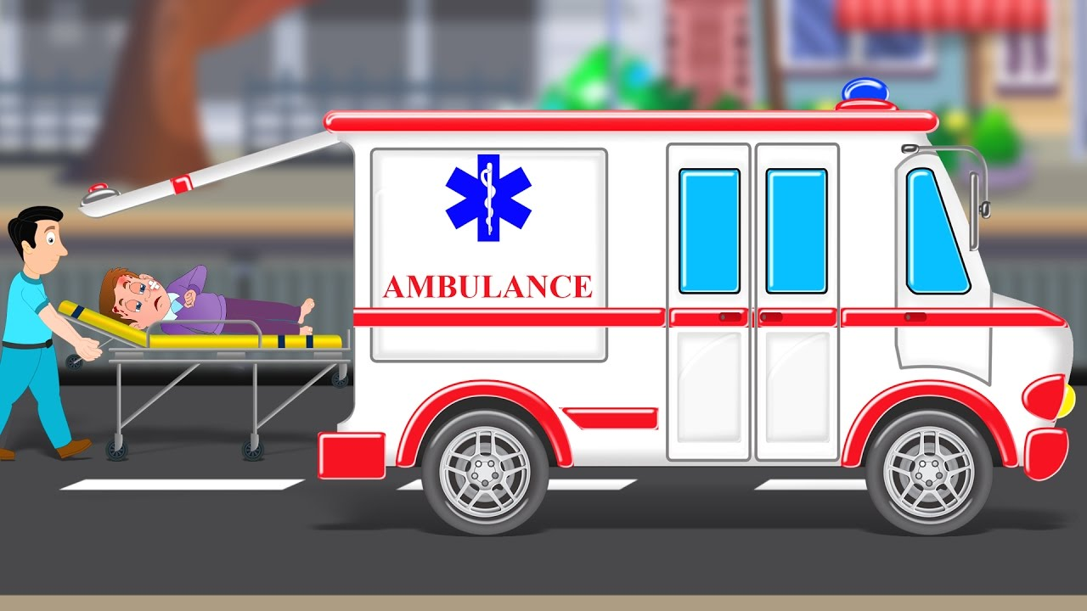
Final Defense
Introduction
Bachao is a web application which will be used to call ambulance, order medicine online, and other emergency helplines.

Slide 5

Final Defense
Motivation
We all learned things from other people and got motivated.
We got motivation from UBER, Pathao, foodpanda.etc.
Uber
Uber Technologies, commonly known as Uber,
is an American multinational ride-hailing
company offering services that include
peer-to-peer ridesharing, ride service
hailing, food delivery , and a micromobility
system with electric bikes and scooters.

Slide 6


Final Defense
Motivation
Pathao
Pathao is the first major ride-shraring company in Bangladesh to get enlistment certificate from the authorities. Pathao is abengali word meaning “Send”.
Foodpanda
Foodpanda is a mobile food delivery
marketplace available in 13 countries.
It is mostly active in Asia Pacific, Bulgaria
and Romania. It is headquartered in Berlin,
Germany. The service allows users to select
from local restaurants and place orders
via its mobile applications as well as its
websites.

Slide 7
Final Defense
Objectives
Finding the nearest ambulance as soon as possible.
Emergency medicine home delivery.
Ensuring easy access of fire service’s contact.
Making it as much as user friendly.

Slide 8
Final Defense
Methodology
Login System
Registered user
For General User
Admin
Homepage
Homepage
Add Ambulance
About
About
View Ambulance
Delete Ambulance
Contact
Contact
Edit Ambulance
Gallery
Registration
Add Medicine
View Ambulance
Gallery
View Medicine
View Medicine
View Medicine
View User
Call Ambulance

Slide 9
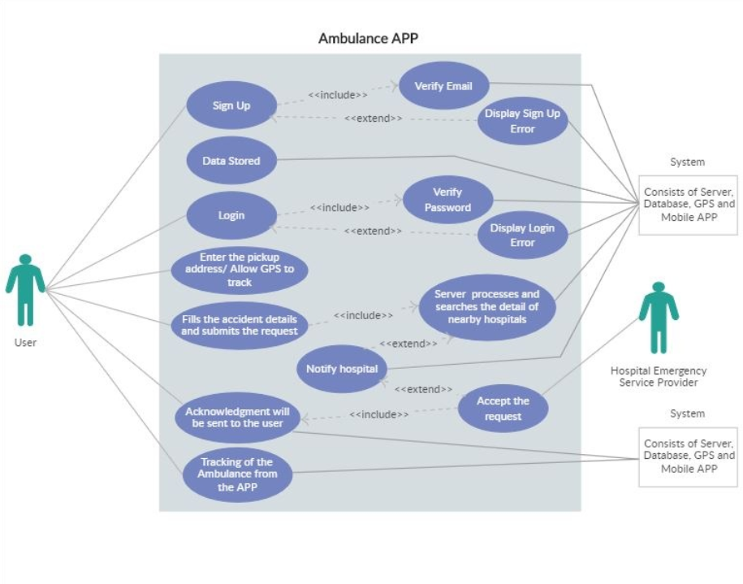
Final Defense
Use Case Diagram

Slide 10
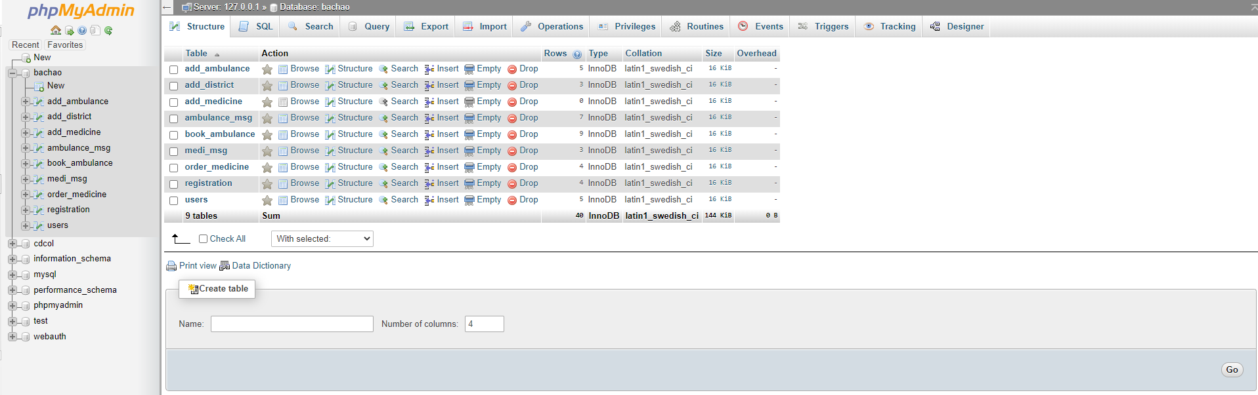
Final Defense
Database
Entire phpmyadmin Database

Slide 11
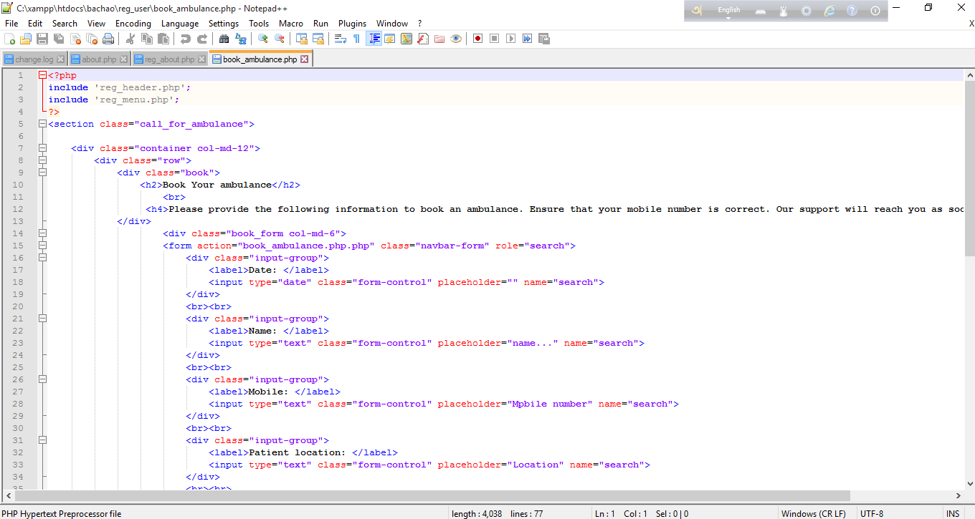
Final Defense
Database
Signing up and login
Call for Ambulance
Placing Medicine order
Sign Out

Slide 12
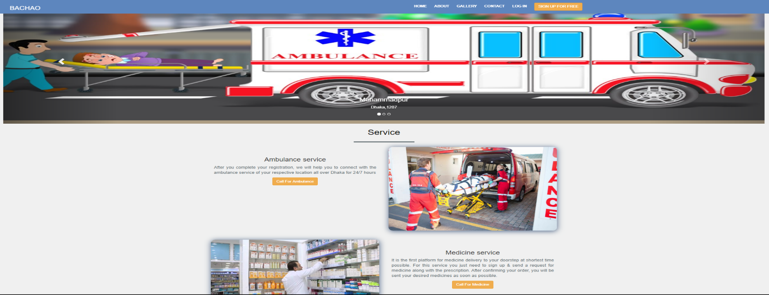
Final Defense
Project Screenshots
Guest’s interface

Slide 13
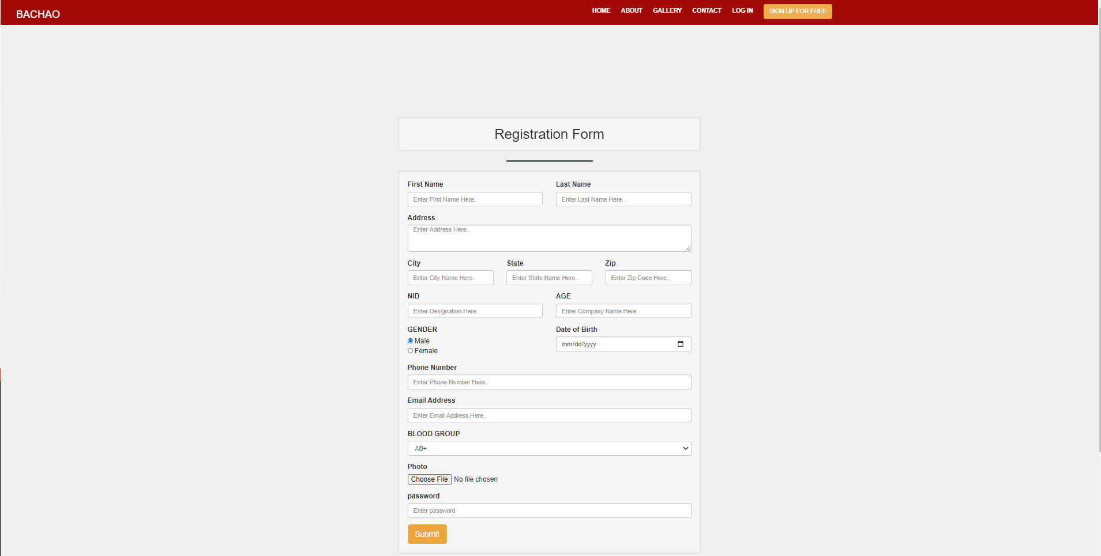
Final Defense
Project Screenshots
Registration

Slide 14
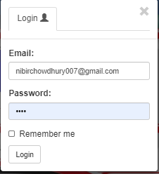
Final Defense
Project Screenshots
Login Dialog

Slide 15
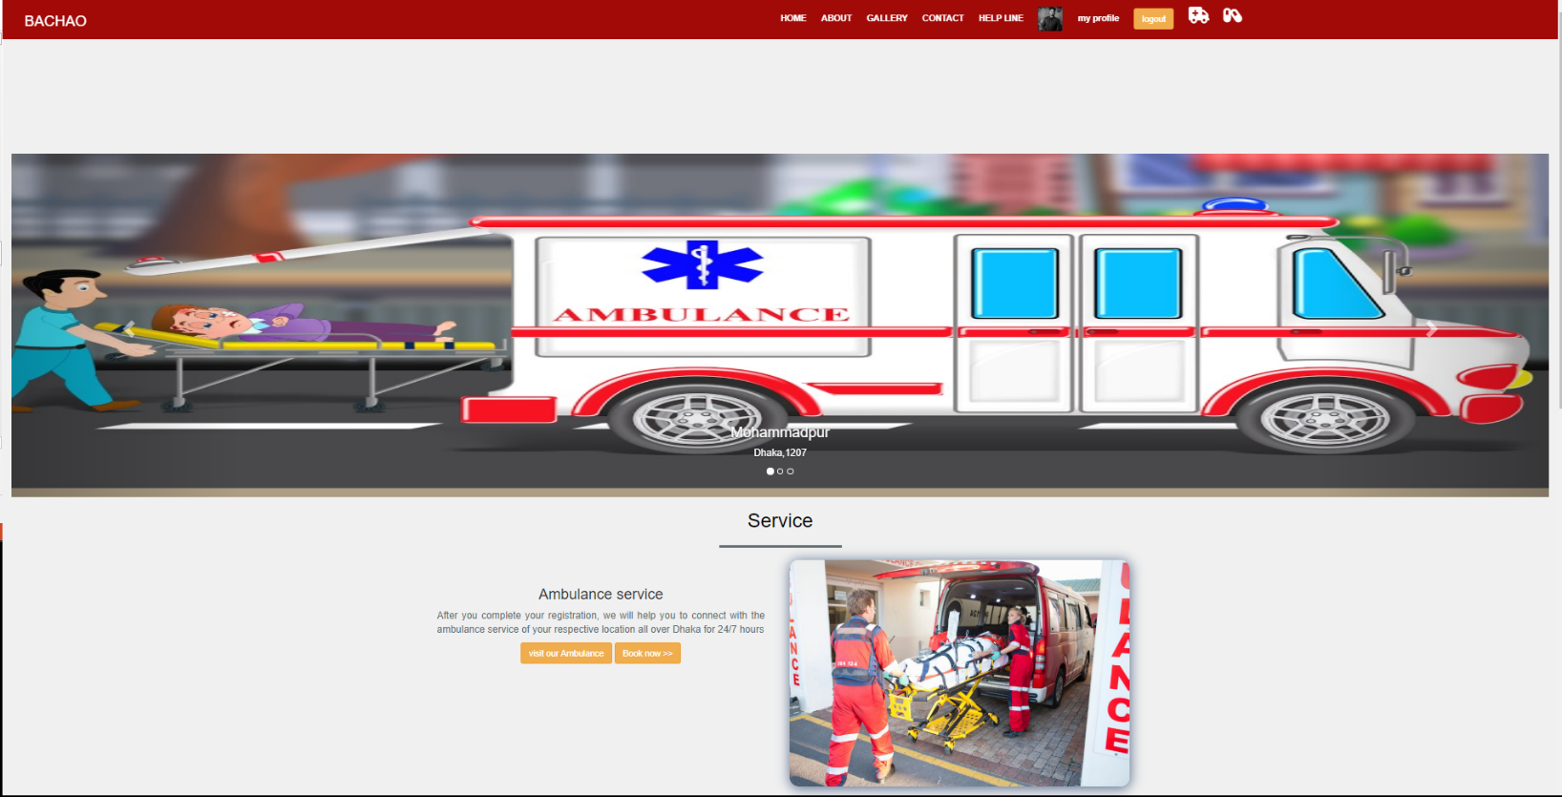
Final Defense
Project Screenshots
Logged In Page

Slide 16
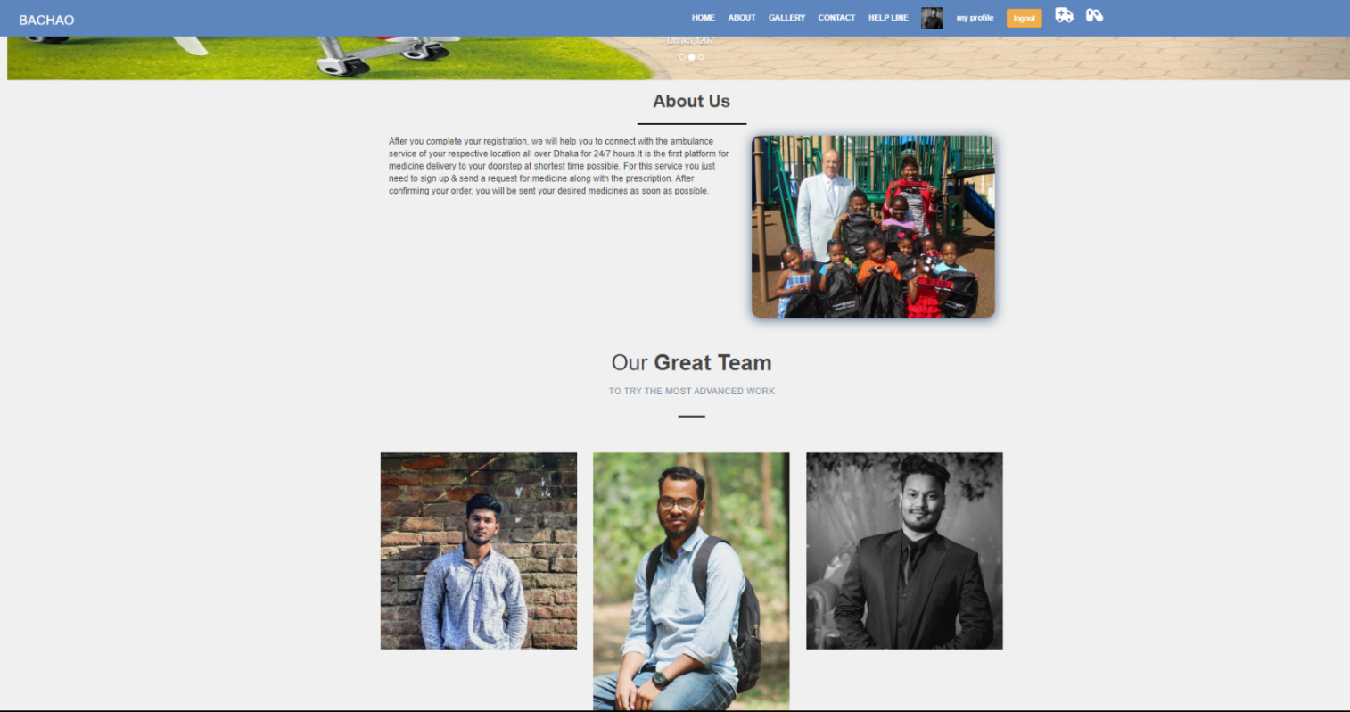
Final Defense
Project Screenshots
About

Slide 17
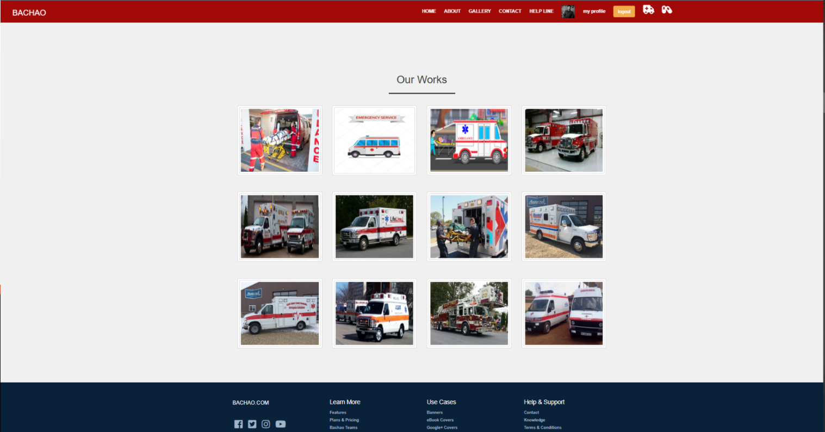
Final Defense
Project Screenshots
Gallery

Slide 18
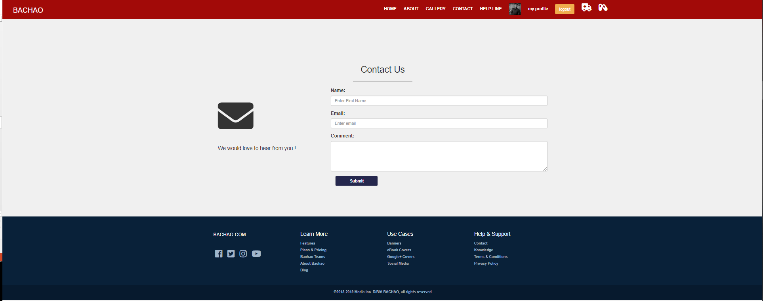
Final Defense
Project Screenshots
Contact Us

Slide 19
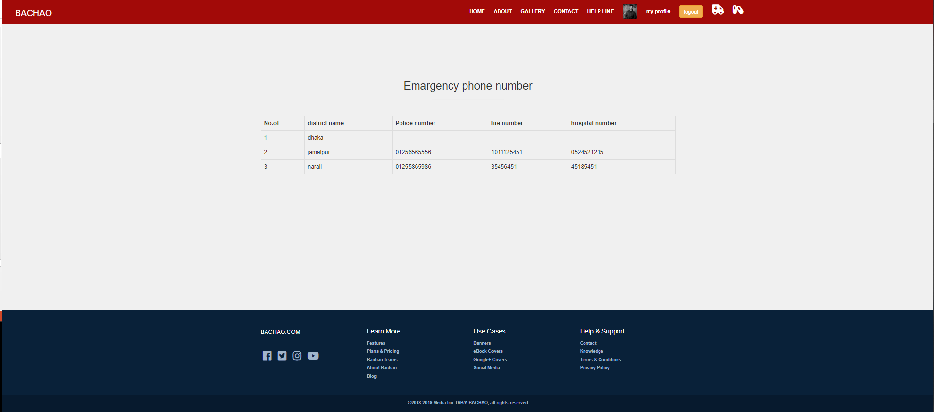
Final Defense
Project Screenshots
Help Line

Slide 20
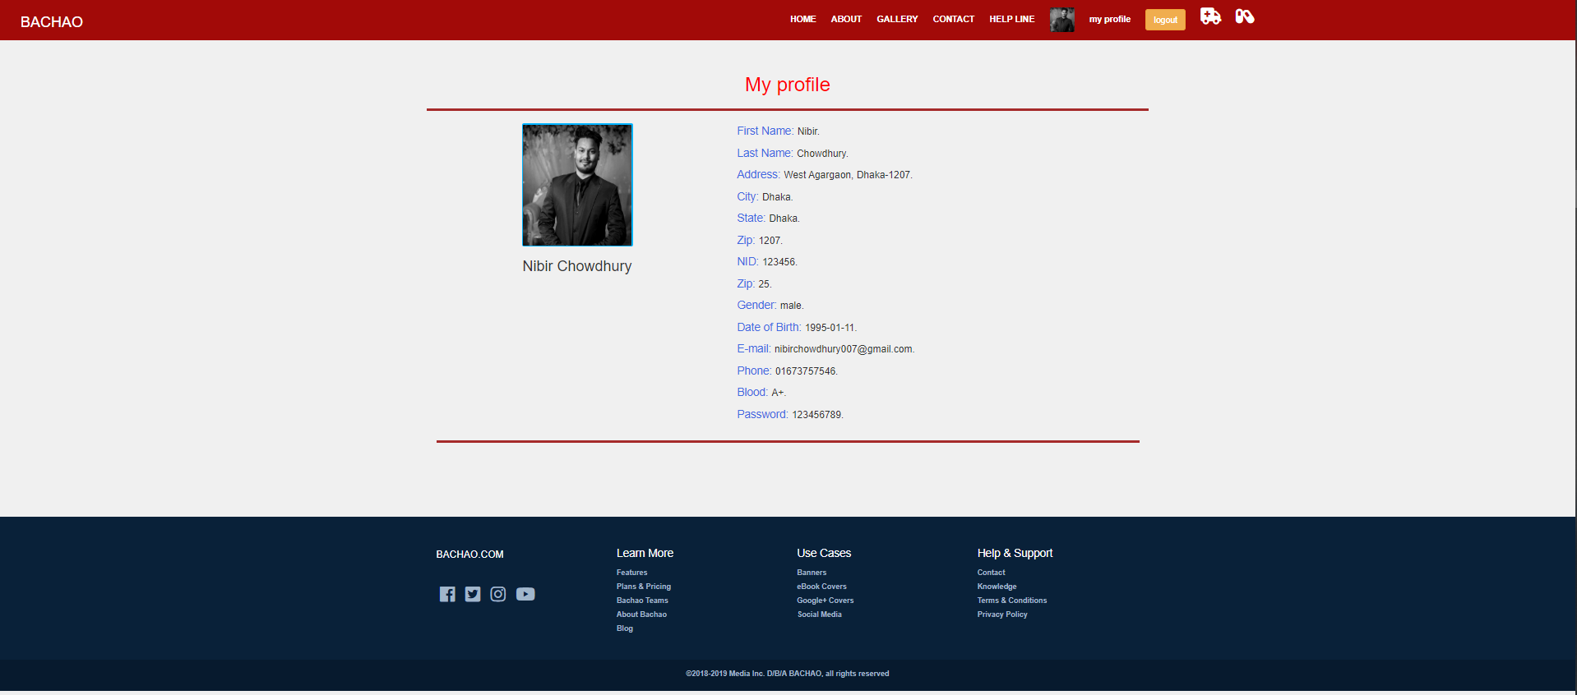
Final Defense
Project Screenshots
User Profile

Slide 21
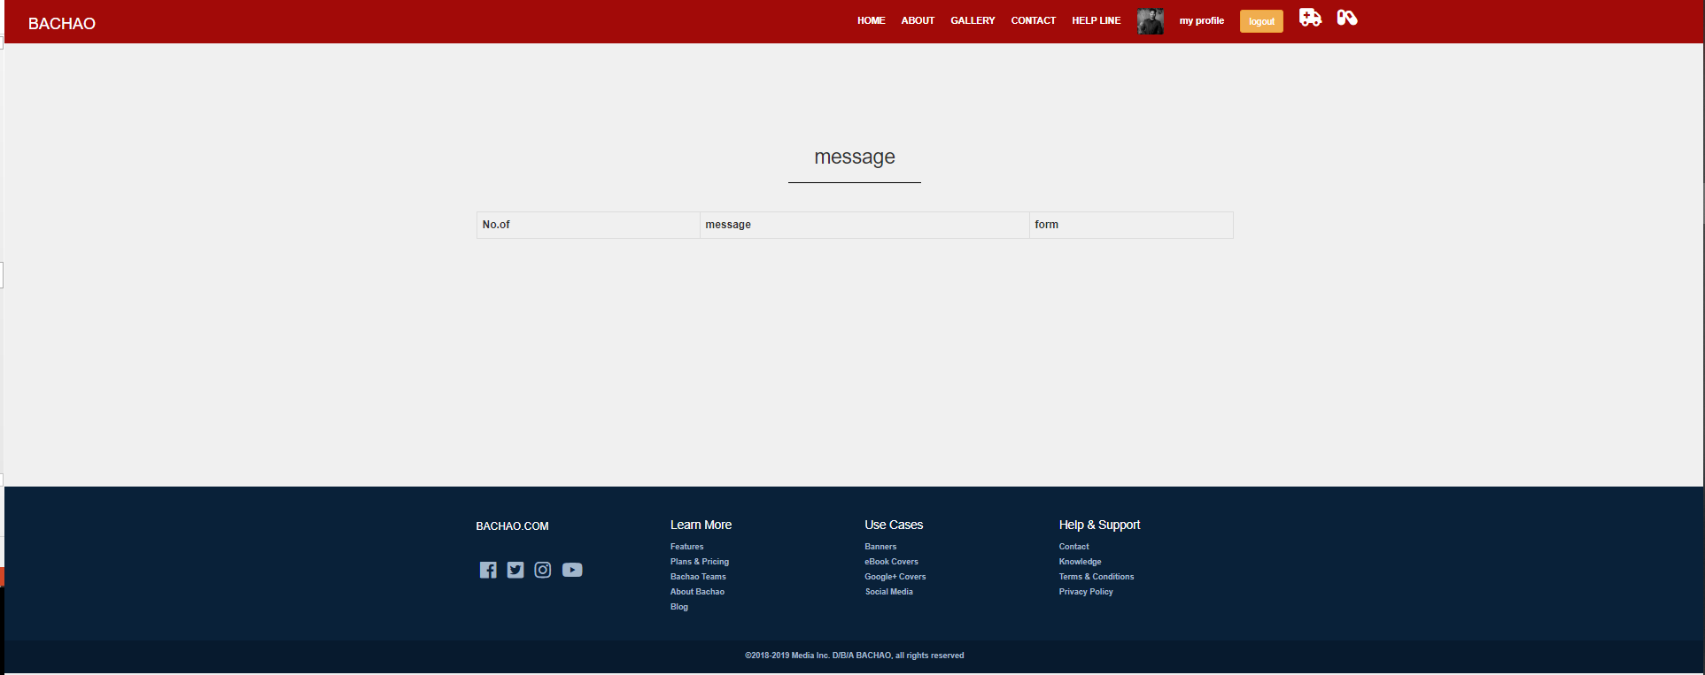
Final Defense
Project Screenshots
Ambulance Message History

Slide 22
Final Defense
Project Screenshots
Medicine Message History

Slide 23
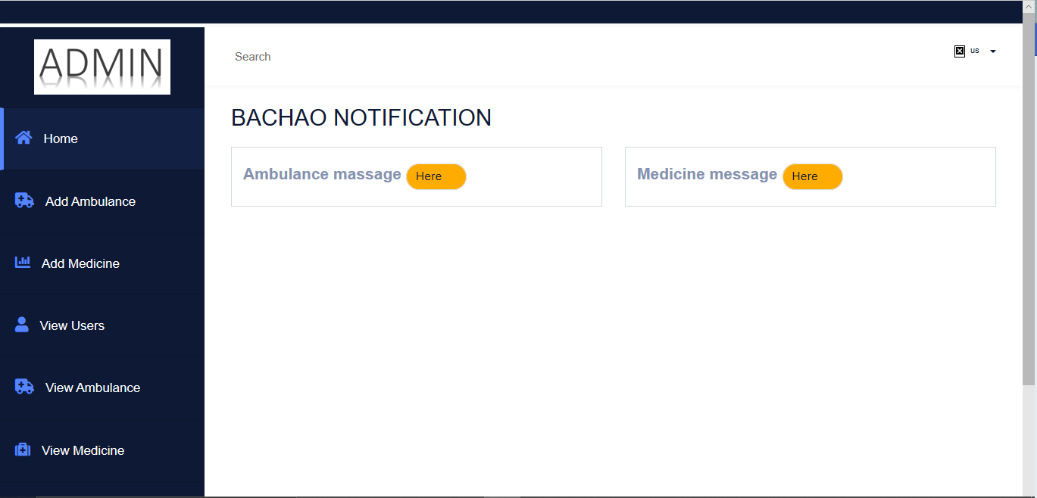
Final Defense
Project Screenshots
Admin Home

Slide 24
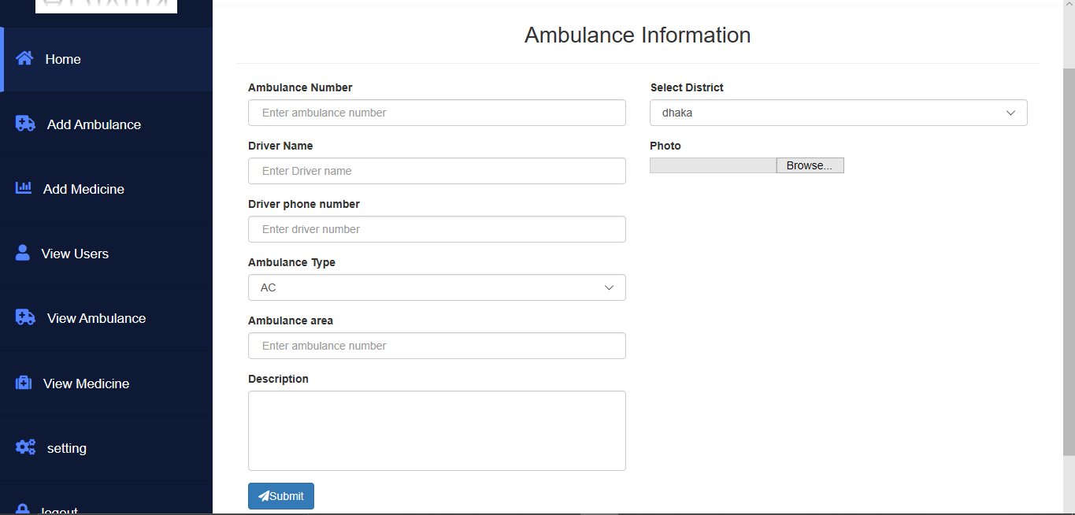
Final Defense
Project Screenshots
Add Ambulance

Slide 25
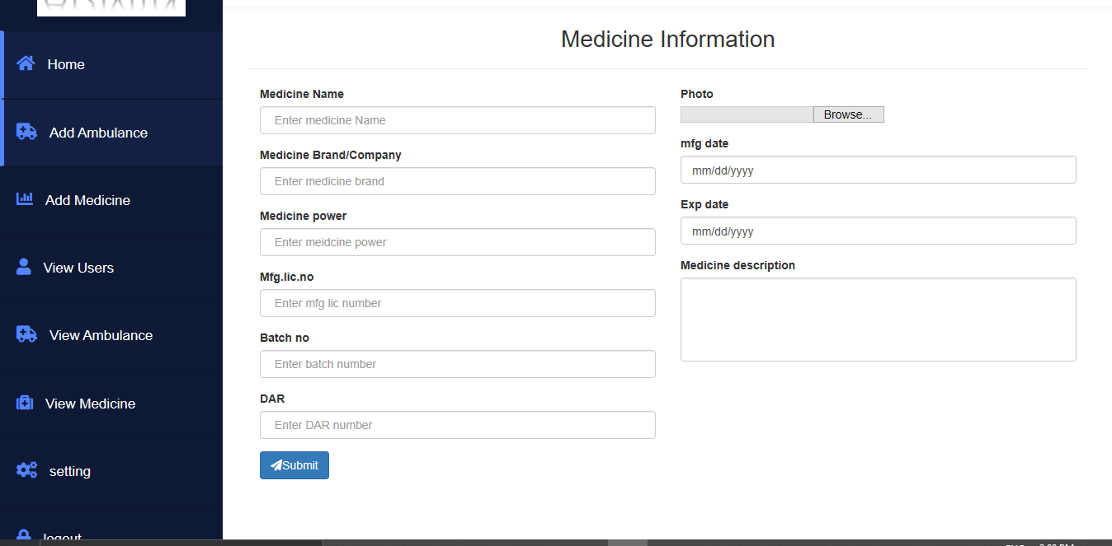
Final Defense
Project Screenshots
Add Medicine

Slide 26
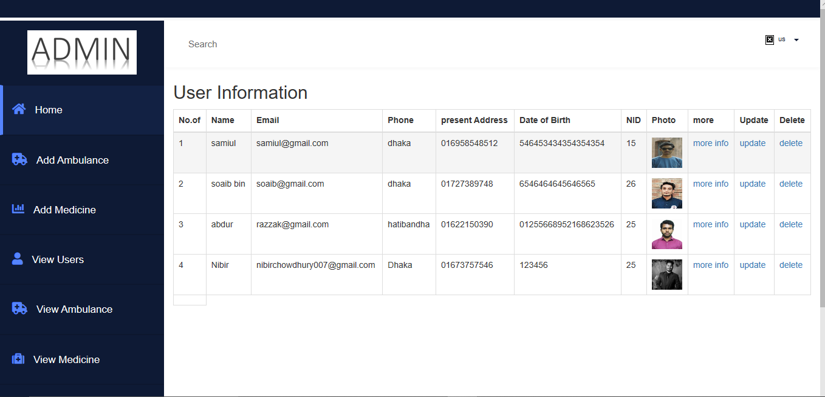
Final Defense
Project Screenshots
View User Info

Slide 27
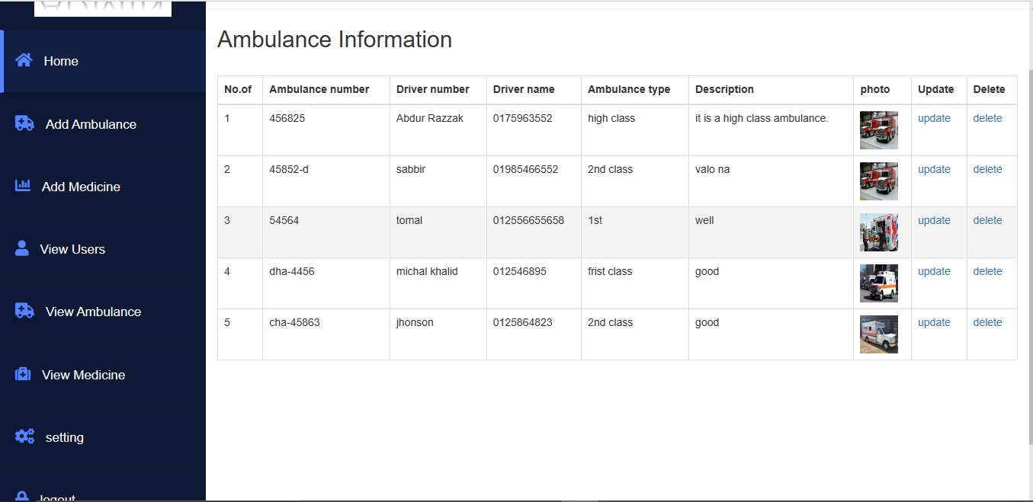
Final Defense
Project Screenshots
View Ambulance Info

Slide 28
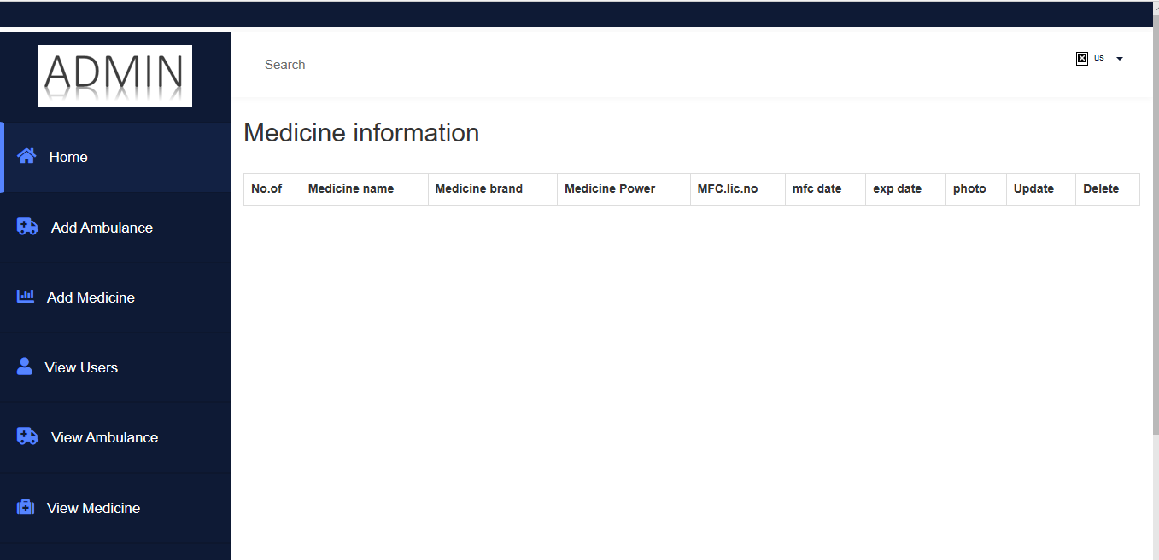
Final Defense
Project Screenshots
View Medicine Info

Slide 29
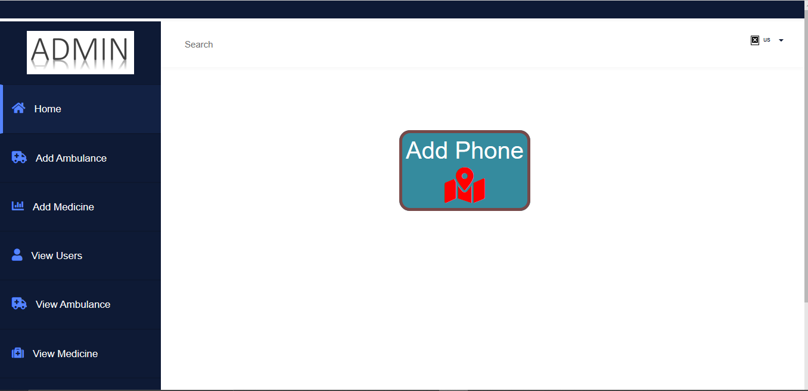
Final Defense
Project Screenshots
Settings and Log Out

Slide 30
Final Defense
Functional Requirements
Guest User:
Guest user can view the whole website but they can not use its facilities .If they need to get the facilities then they have to be registered.
Register User:
Register user can view the whole website and also can get all facilities. For an example: They can book ambulance and medicine.
Admin User:
Admin user have all the access of this website .They can modify anything if there needs.

Slide 31
Final Defense
Features
Booking Ambulance
Online Medicine Ordering
Hospital details
Fire Service Contact Details

Slide 32
Final Defense
Development Procedure
Requirement
Analysis
System Design
Implementation
Testing
Development
Deployment

Slide 33
Entity Relationship Diagram
Final Defense
Address
Number of patients
Name
Email
Relationship
Retesting
User
ID
Phone number
Request
Admin
Ambulance
Medicine

Slide 34
Expected Outcome
Final Defense
Building a new platform for online based ambulance booking system.
Ordering medicines and providing home delivery.
New possibilities of income for ambulance owners.
Easy access of fire service contact details.

Slide 35
Technology Used
Final Defense
Front End
Php CSS
Java Scrpt
Back End
Database
Server

Slide 36
Future Plans
Final Defense
Mobile accessible.
More user friendly.
Blood donation feature.
Contacting directly with doctors.

Slide 37
Conclusion
Final Defense
This project of ours is an ongoing prospect. We will try to make our website smoother and more user friendly.

Slide 38
References
Final Defense
1. Elgarej Mouhcine, Yassine Karouani, Khalifa Mansouri, Youssfi Mohamed , “Toward a Distributed Strategy
for Emergency Ambulance Routing Problem” , ENSET University Hassan II Mohammedia, Morocco, pp 02-03
2. Omkar Udawant, Nikhil Thombare, Devanand Chauhan, Akash Hadke, “ Smart Ambulance System using
IoT” , Dattatray Waghole, JSCOE, PUNE, INDIA, pp 01-03
3. Huber Nieto-Chaupis , “RASUS: Rapid Assistance System through Uber-inspired Software for localization
on-line of nurses and doctors ” , Universidad de Ciencias y Humanidades UCH, 5175 Los Olivos Lima39 Peru ,
pp 02-04
4. what is Uber ? New scientist volume 232,Issue 3102, 3 December 2016,pp6

